Slide 1
AERODYNAMICS
د. محمد خضير عباس

Slide 2
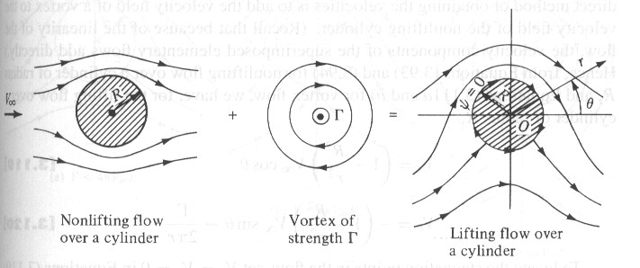
Combination of elementary flows
Superposition of a uniform flow and a source
Stream function ψ

Slide 3
Velocity field
Stagnation point
The streamline goes through the stagnation point is described by ψ=Λ/2, shown as curve ABC .

Slide 4
Streamline ABC separates the fluid coming from the free stream and the fluid emanating from the source.
The entire region inside ABC could be replaced with a solid body of the same shape.

Slide 5
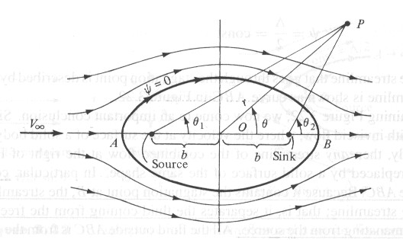
Superposition of a uniform flow and a source-sink pair
Stream function ψ

Slide 6
Two stagnation points A and B are found by setting V=0.
The stagnation streamline is given by ψ=0, i.e.
which is the equation of an oval, called Rankine oval.
The region inside the oval can be replaced by a solid body with the same shape.

Slide 7
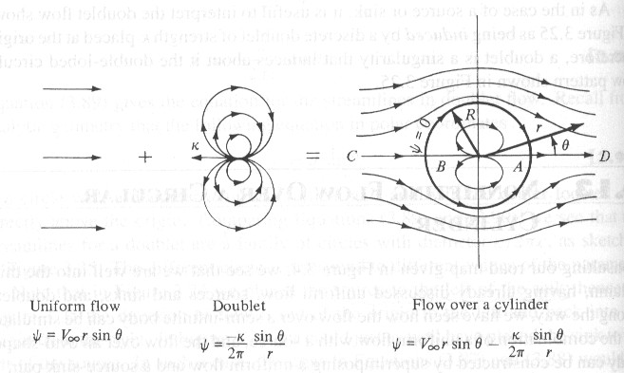
Nonlifting flow over a circular cylinder
Superposition of a uniform flow and a doublet
Stream function ψ

Slide 8
Velocity field
The stagnation streamline is given by ψ=0, i.e.
The stagnation streamline includes the circle described by r=R, and the entire horizontal axis through points A and B.

Slide 9
We can replace the flow inside the circle by a solid body. Consequently, a flow over a circular cylindrical of radius R can be synthesized by this superposition, where
The pressure distribution is symmetric about both axes. As a result, there is no net lift, as well as no net drag which makes no sense in real world.

Slide 10
Chap.4
Incompressible Flow over Airfoils

Slide 11
OUTLINE
Airfoil nomenclature and characteristics
The vortex sheet
The Kutta condition
Kelvin’s circulation theorem
Classical thin airfoil theory
The cambered airfoil
The vortex panel numerical method

Slide 12
Airfoil nomenclature and characteristics
Nomenclature

Slide 13
Characteristics

Slide 14
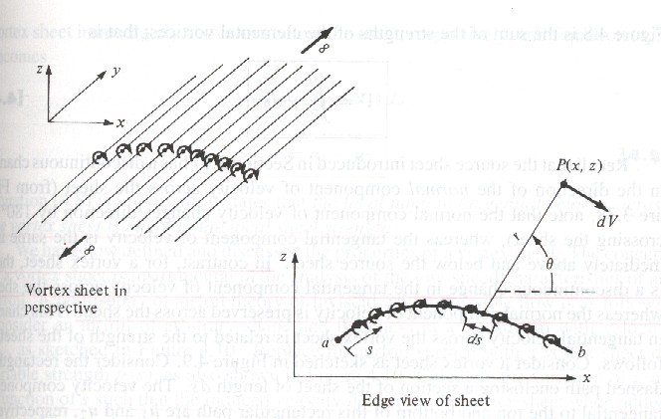
The vortex sheet
Vortex sheet with strength γ=γ(s)
Velocity at P induced by a small section of vortex sheet of strength γds
For velocity potential (to avoid vector addition as for velocity)

Slide 15
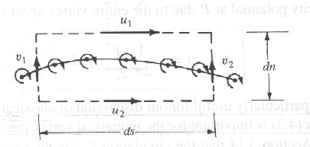
The velocity potential at P due to entire vortex sheet
The circulation around the vortex sheet
The local jump in tangential velocity across the vortex sheet is equal to γ.

Slide 16
Calculate γ(s) such that the induced velocity field when added to V∞ will make the vortex sheet (hence the airfoil surface) a streamline of the flow.
The resulting lift is given by Kutta-Joukowski theorem
Thin airfoil approximation

Slide 17
The Kutta condition
Statement of the Kutta condition
The value of Γ around the airfoil is such that the flow leaves the trailing edge smoothly.
If the trailing edge angle is finite, then the trailing edge is a stagnation point.
If the trailing edge is cusped, then the velocity leaving the top and bottom surface at the trailing edge are finite and equal.
Expression in terms of γ

Slide 18
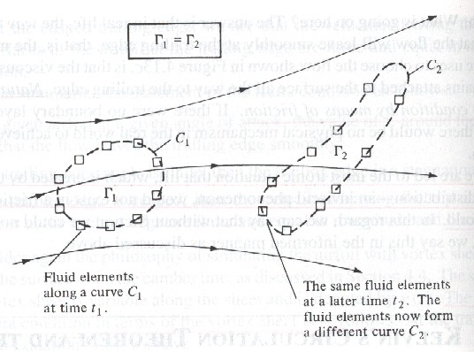
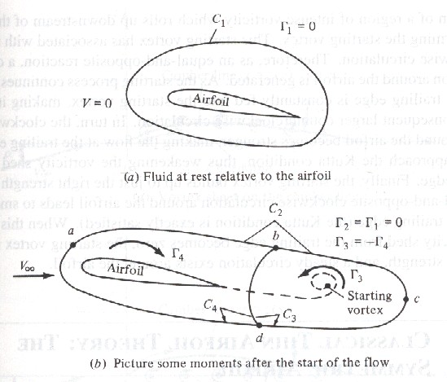
Kelvin’s circulation theorem
Statement of Kelvin’s circulation theorem
The time rate of change of circulation around a closed curve consisting of the same fluid elements is zero.

Slide 19
Classical thin airfoil theory
Goal
To calculate γ(s) such that the camber line becomes a streamline.
Kutta condition γ(TE)=0 is satisfied.
Calculate Γ around the airfoil.
Calculate the lift via the Kutta-Joukowski theorem.

Slide 20
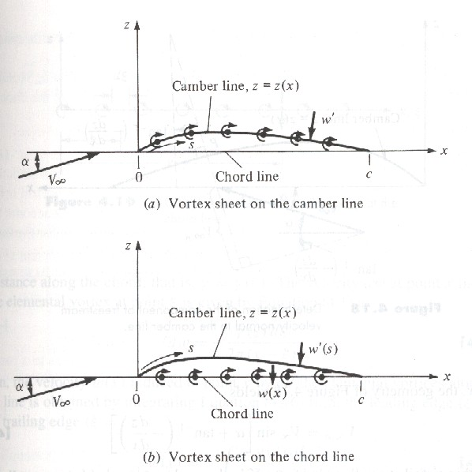
Approach
Place the vortex sheet on the chord line, whereas determine γ=γ(x) to make camber line be a streamline.
Condition for camber line to be a streamline
where w'(s) is the component of velocity normal to the camber line.

Slide 21
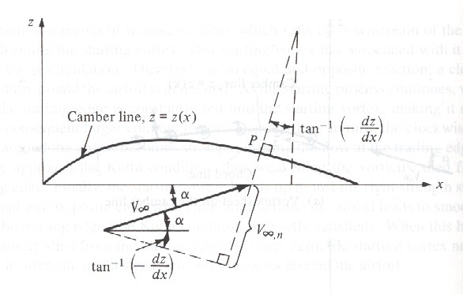
Expression of V∞,n
For small α

Slide 22
Expression for w(x)
Fundamental equation of thin airfoil theory

Slide 23
For symmetric airfoil (dz/dx=0)
Fundamental equation for γ(ξ)
Transformation of ξ, x into θ
Solution

Slide 24
Check on Kutta condition by L’Hospital’s rule
Total circulation around the airfoil
Lift per unit span

Slide 25
Lift coefficient and lift slope
Moment about leading edge and moment coefficient

Slide 26
Moment coefficient about quarter-chord
For symmetric airfoil, the quarter-chord point is both the center of pressure and the aerodynamic center.

Slide 27
The cambered airfoil
Approach
Fundamental equation
Solution
Coefficients A0 and An

Slide 28
Aerodynamic coefficients
Lift coefficient and slope
Form thin airfoil theory, the lift slope is always 2π for any shape airfoil.
Thin airfoil theory also provides a means to predict the angle of zero lift.

Slide 29
Moment coefficients
For cambered airfoil, the quarter-chord point is not the center of pressure, but still is the theoretical location of the aerodynamic center.

Slide 30
The location of the center of pressure
Since
the center of pressure is not convenient for drawing the force system. Rather, the aerodynamic center is more convenient.
The location of aerodynamic center

Slide 31
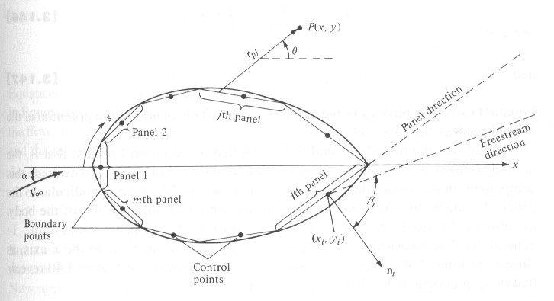
The vortex panel numerical method
Why to use this method
For airfoil thickness larger than 12%, or high angle of attack, results from thin airfoil theory are not good enough to agree with the experimental data.
Approach
Approximate the
airfoil surface by
a series of straight
panels with strength
which is to be
determined.

Slide 32
The velocity potential induced at P due to the j th panel is
The total potential at P
Put P at the control point of i th panel

Slide 33
The normal component of the velocity is zero at the control points, i.e.
We then have n linear algebraic equation with n unknowns.

Slide 34
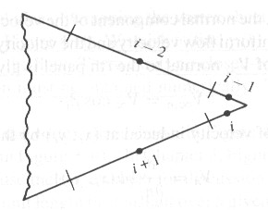
Kutta condition
To impose the Kutta condition, we choose to ignore one of the control points.
The need to ignore one of the control points introduces some arbitrariness in the numerical solution.

Slide 35
Chap.5
Incompressible Flow over Finite Wings

Slide 36
OUTLINE
Downwash and induced drag
The Biot-Savart law and Helmholtz’s theorems
Prandtl’s classical Lifting-line theory
Elliptical lift distribution
General lift distribution

Slide 37
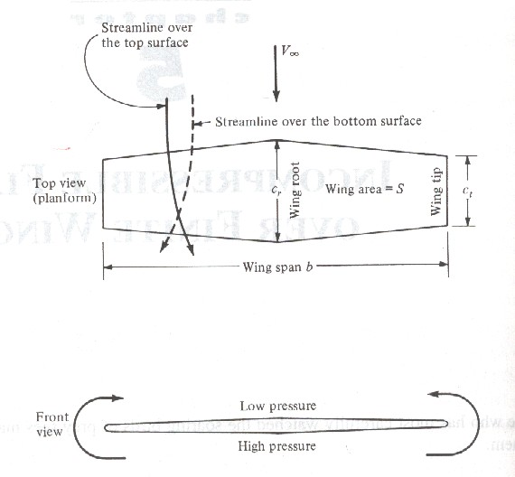
Downwash and induced drag
Aerodynamic difference between finite wing and airfoil
For finite wing, the flow near wing tips tends to curl around the tip, being forced from the high- pressure just underneath the tips to the low- pressure region on top.

Slide 38
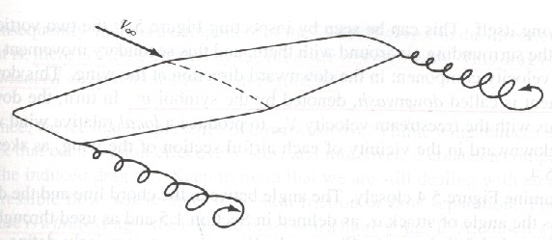
Due to the spanwsie component of flow from tip toward to root, the streamlines over the top surface are bent toward root. In contrast, the streamlines over bottom surface toward tip.
A trailing vortex is created at each win tip.

Slide 39
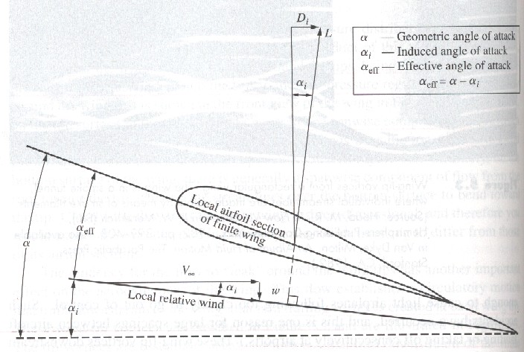
Effect of downwash
Wing-tip vortices downstream of the wing induce a small component of air velocity, called downwash which is denoted by the symbol w.
Downwash causes inclining the local relative wind in the downward direction.

Slide 40
Effective angle of attack
The tilting backward of the lift vector induce a drag, called induced drag Di which is a type of pressure drag.
Total drag = Profile drag + Induce drag, therefore

Slide 41
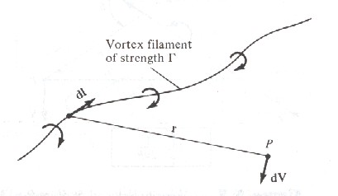
The Biot-Savart law and Helmholtz’s theorems
The Biot-Savart law
The velocity at point P, dV, induced by a small directed segment dl of a curved filament with strength Γ is
The velocity at P by a
straight vortex filament
of infinite length is

Slide 42
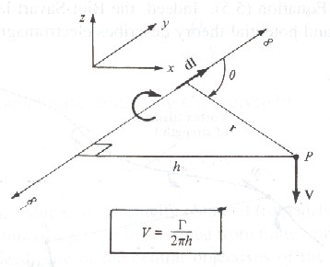
The magnitude of V
The velocity at P by a semi-infinite vortex filament

Slide 43
Holmholtz’s vortex theorem
The strength of a vortex filament is constant along its length.
A vortex filament cannot end in a fluid; it must extend to the boundaries of the fluid (which can be ±∞) or form a closed path.
Lift distribution
Different airfoil sections may have geometric and aerodynamic twist, that results in a lift distribution along the span.

Slide 44
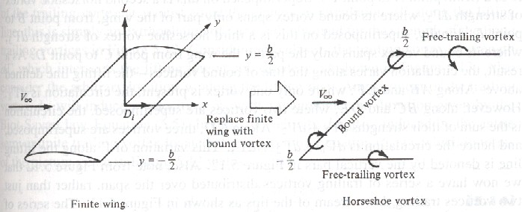
Prandtl’s classical Lifting-line theory
Horseshoe vortex
Horseshoe vortex consists of a bound vortex and two free vortex.
The bound vortex induces no velocity along itself, however, the two free vortices contribute to the downward velocity along the bound vortex.

Slide 45
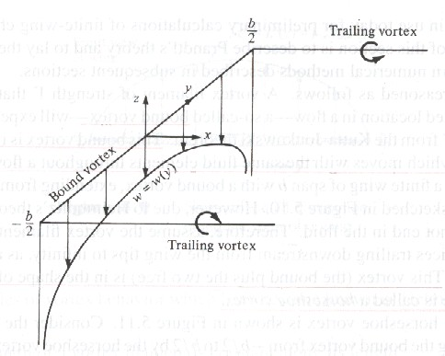
Downwash
Downwash at point y along the bound vortex is

Slide 46
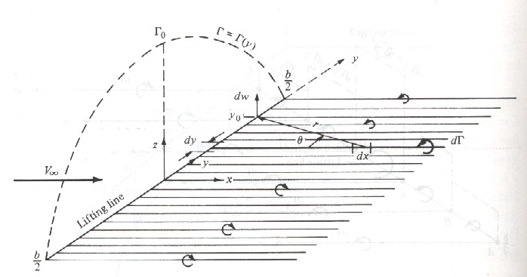
Lifting-line theory
Instead of a single horseshoe vortex, infinite number of horseshoe vortices with a vanishing small strength dΓ are superimposed to form the bound vortices a single line which is called lifting line.

Slide 47
The trailing vortices become a continuous vortex sheet trailing downstream of the lifting line.
The velocity w induced at y0 by the entire trailing vortex sheet is
The induce angle of attack is

Slide 48
The lift coefficient at y=y0 is
From the Kutta-Joukowski theorem, lift for the local airfoil section located at y0 is
Expression of effective angle of attack

Slide 49
Fundamental equation of Prandtl’s lifting-line theory (integro-differential equation of Γ)
The solution Γ gives the three main aerodynamic characteristics of a finite wing

Slide 50
The lift distribution
The lift coefficient
The induced drag coefficient

Slide 51
Elliptical lift distribution
Charateristic
Elliptical circulation distribution
where Γ0 is the circulation at the origin.
Elliptical lift distribution
Zero lift at the wing tips

Slide 52
Resulting aerodynamic properties
By using the transformation y=b/2 cosθ, we obtain
which states that downwash is constant over the span for an elliptical lift distribution.
Induced angle of attack

Slide 53
Induced drag coefficient
which states that CD,I is proportional to the square of CL and inversely proportional to AR.
For an elliptical lift distribution, the chord must vary elliptically along the span; that is, the wing planform is elliptical.

Slide 54
General lift distribution
Characteristic
Consider the transformation
and assume
Fundamental equation at a given location

Slide 55
We may choose N different spanwise stations, then we can obtain N independent algebraic equations with N unknowns, namely, A1, A2, …AN.
Resulting aerodynamic properties
Lifting coefficient
Induced drag coefficient

Slide 56
Define span efficiency factor e
Note that δ=0 and e=1 for the elliptical lift distribution. Hence, the lift distribution which yields minimum induced drag is the elliptical lift distribution.

